Slide 1
Wikidata.lib
BP2013N2
InfoLunch 05.02.2014

Slide 2
Agenda
Wiederholung: PropertySuggester
Edit Item Page
Evaluation
Hackathon

Slide 3
Rank Properties for a Given Property Set
 | 1 | 2 | 3 | 4 | 5 | 6 | 7 | 8 | 9 | 10 | 11
1 | / | 0.2 | 0.4 | / | 0.1 | / |  | 0.3 | / |  | 0.6
2
3
4 | / | 0.4 | 0.5 | / | 0.7 | / | 0.1 | 0.4 | / |  | 0.5
5
6 | / | 0.8 | 0.9 | / | 0.1 | / | 0.1 | 0.4 | / |  | 0.1
7
8
9 | / | 0.5 | 0.1 | / | 0.2 | / | 0.9 | 0.7 | / |  | 0.1
10
11
S = {1,4,6,9}
This is how we rank suggestions!
+
+
+
+
+
+
Probability Sum for Property_{Column}
/ #S = normalized Probability [0,1]

Slide 4
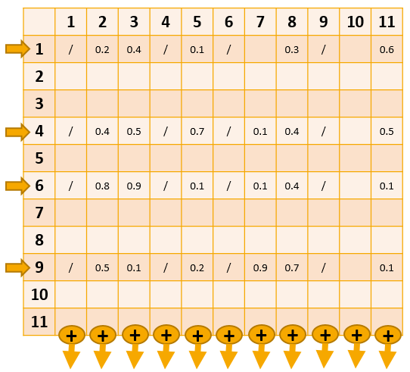
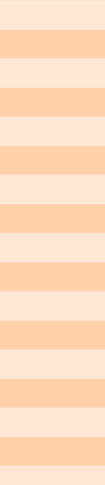
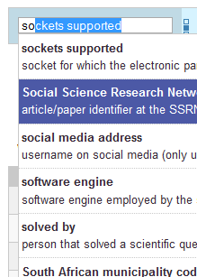


Combine Search Results
• Provide stability (e.g. new properties wouldn’t appear in suggestions…)
• Complex because of paging (offset, limit)
get suggestions
apply search
enough suggestions for
given offset & limit?
yes
our
suggestions
no
eliminate duplicates &
append to suggestions
former
search
results
get results
(search already applied)

Slide 5
Edit Item Page

Slide 6
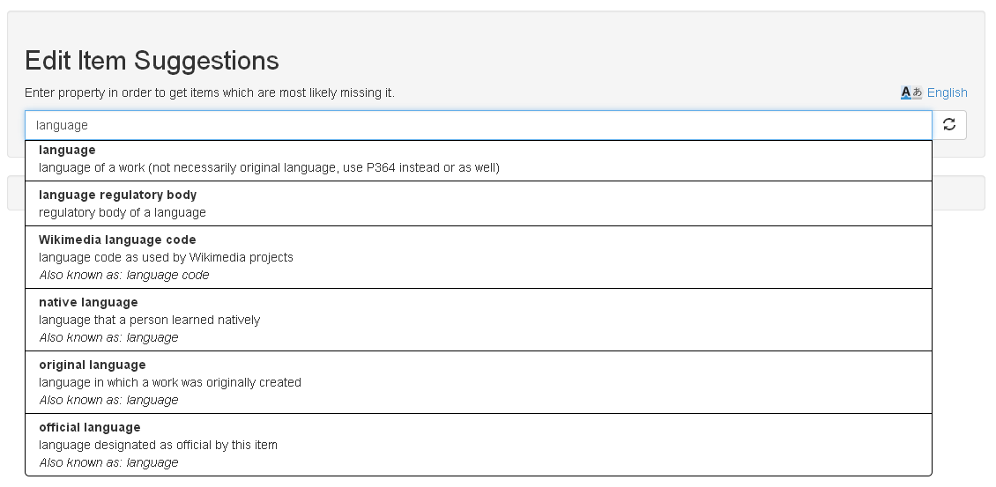
Notes:
Eigenschaft eingeben
Items, wo die Eigenschaft fehlt

Slide 7
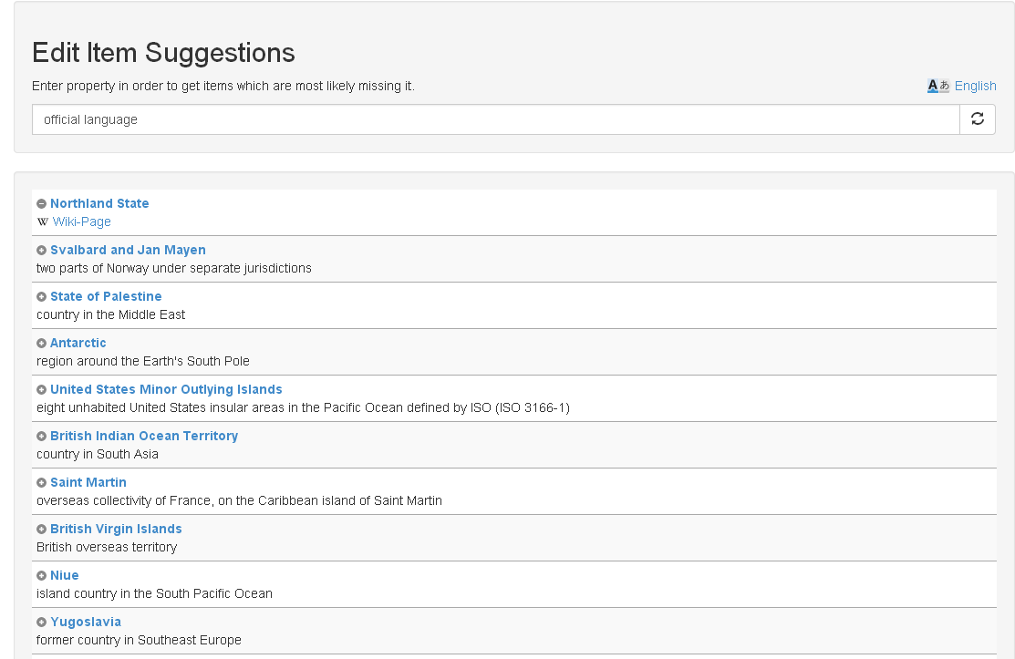
Notes:
Nach 10 min check ob es eingetragen wurde
Verschwindet von Website
Wikipedia Link
Direktes Eintragen
Gute Resonanz auf Wikidata mailingliste

Slide 8
Evaluation

Slide 9
Algorithm
Random Item
Suggester
Property 21
Property 33
Property 8
Property 4
getSuggestions
compare
result
Property 15
Property 4
Property 38
Property 24

Slide 10
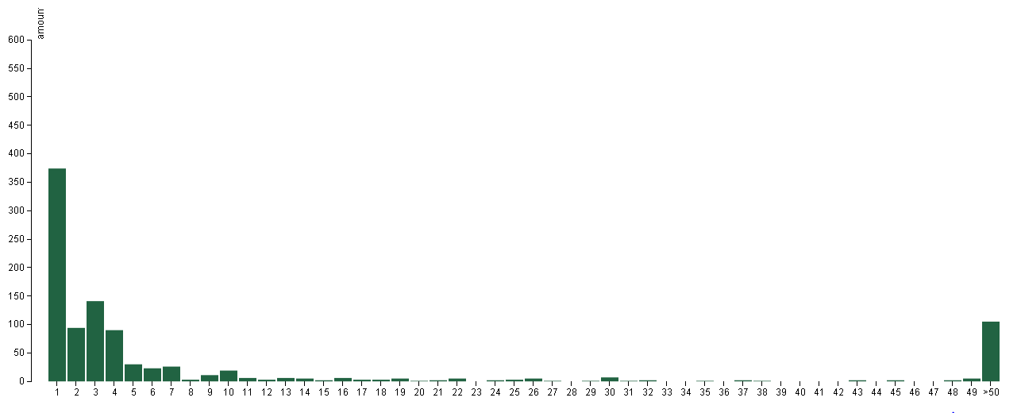
Results

Slide 11
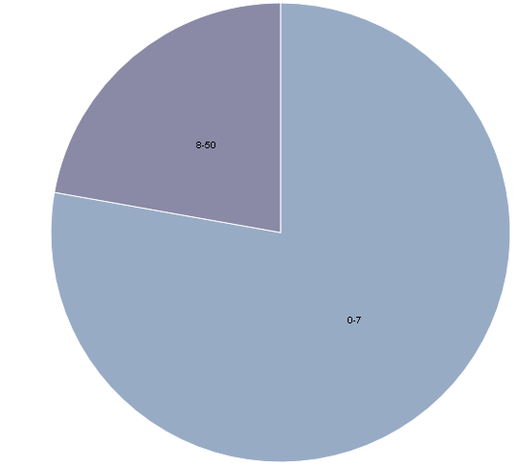
Distribution
8-50
1-7

Slide 12
First letter Algorithm
Random Item
Suggester
Property 21
Property 33
Property 8
Property 4
getSuggestions, search= firstLetter
compare
result
Property 15
Property 4
Property 38
Property 24
Notes:
Extended algorithm:
Provide first letter of missing property as search parameter for suggester
Use Case: User is starting to type

Slide 13
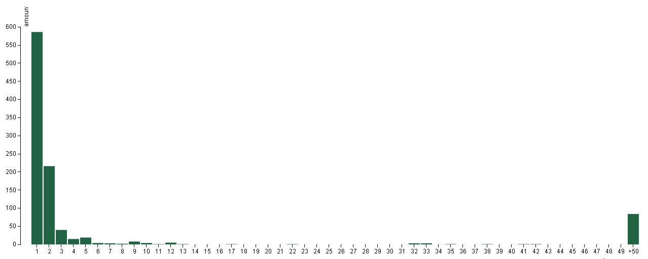
First letter evaluation

Slide 14
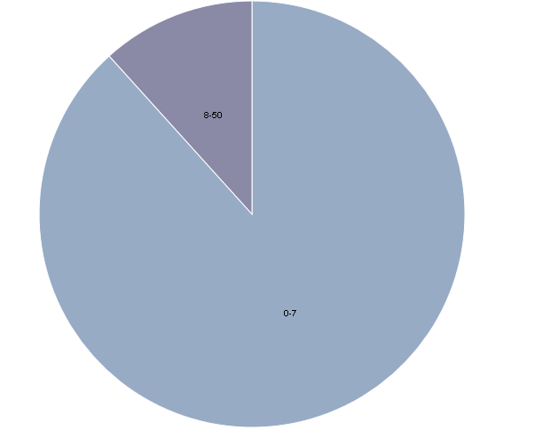
Distribution
8-50
1-7
Notes:
Blau: 1-7

Slide 15
data
Output:
CSV File
Amount per rank
Input: CSV file (preprocessed Wikidata csv dump) Total amount of items in dump: 6656575
Q15, 31, wikibase-entityid, Q5107 Q15, 47, wikibase-entityid, Q48 Q15, 361, wikibase-entityid, Q2 Q15, 47, wikibase-entityid, Q46 Q15, 373, string, Africa Q15, 18, string, Africa satellite.jpg Q15, 242, string, Africa ethnic groups 1996.jpg Q15, 242, string, Afriko-meza.png Q15, 625, globecoordinate, N7.186, E21.011 Q15, 910, wikibase-entityid, Q5460710
…
rank, amount
1, 374
2, 94
3, 141
4, 90
5, 30
6, 23
7, 26
8, 3
9, 11
10, 19
…

Slide 16


Implementation
Evaluator
Python
Modular structure to easily extend existing implementation
Visualization
d3.js
bar chart and pie chart
processes csv file

Slide 17
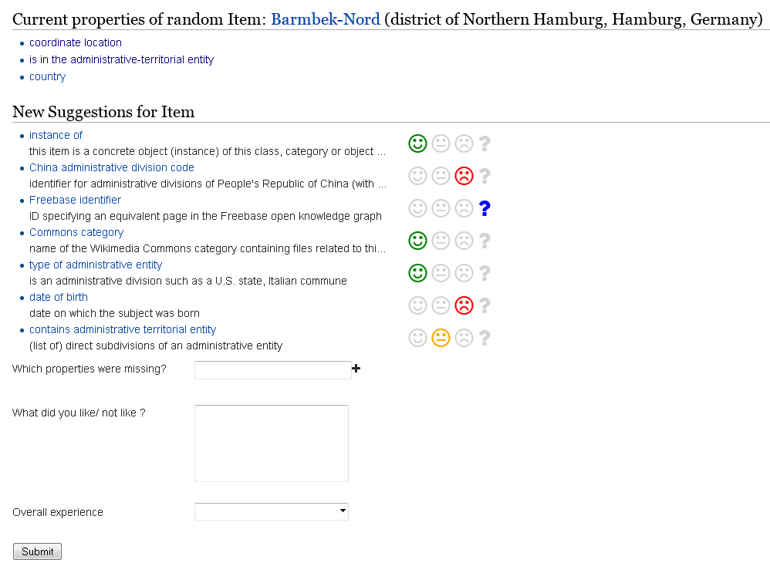
User Feedback Evaluation
User feedback to determine relevance (options)
User ranks suggestions to not relevant and relevant
Created a website for feedback
Crowdsourcing
Wikidata mailing list: 100 people

Slide 18
Hackathon Impressions

Slide 19


